Slide 1
Ilista A MADT 6114 Project
Dogukan Karayilanoglu C0755495
Rosette Lopez Pardillo C0768425

Slide 2
ILISTA PROJECT ASSETS
GITHUB
Repository contains Source Code, Video Demo & PPTX
https://github.com/otetLopez/ilista.git
PPT
Aside from committed in GITHUB Repo in link above, pptx is also uploaded in dropbox and also saved in: https://docs.google.com/presentation/d/1KEwtPZtZuaSZ9pmEGQHwpUI4ZfYsNijoT8IGHdyFhlc/edit?usp=sharing
VIDEO
Aside from committed in GITHUB Repo in link above, video demo is also uploaded in dropbox
This Photo by Unknown Author is licensed under CC BY-SA
This Photo by Unknown Author is licensed under CC BY-SA

Slide 3

ILISTA PURPOSE
ILISTA application is a simple note application implemented using react.
There may be several note applications available in Application stores but the sole purpose for this project is to showcase each members learnings on 6114 class
The team has chosen to implement a note taking application because we can conclude that we have acquired the fundamentals of the technology if we can implement a note application. A note application although may appear to be simple but it is full packed with functionalities to support.
ILISTA has basic features which a note taking app has and will soon be upgraded for the Capstone project

Slide 4
ILISTA Javascript Fundamentals
JavaScript Object Programming
React Components
CRUD Functionality
Event Handling
Web and Mobile Support

Slide 5
ILISTA features
Note List Display
The home page, or main page shows all the list of notes created by the user.
Contains the button for adding a new note
Add Note
User can add new note and enters details of a new note, the title and contents
Update Note
Entered notes can be updated by clicking the title of the note, list in main page will be updated
Delete Note
Entered notes can be deleted, list in main page will be updated

Slide 6
ilista UML DIAGRAM

Slide 7
ilista FUNCTION DIAGRAM
Browser/Device
ILISTA
APPLICATION
ADD NOTE
USER
MAIN VIEW NOTE LIST
UPDATE NOTE
DELETE NOTE

Slide 8
ILISTA Note List display Page
This is the default view of the application. The following images shows ILISTA ran in an Iphone XSMax when there are no notes created(left) and when there are notes created(right)

Slide 9
ILISTA ADD NOTE
When the PLUS button from Note Display is clicked, the Add Note UI is rendered, allowing user add a new note and input its details

Slide 10
ILISTA UPDATE NOTE
When the title of an existing note is clicked, it allows user to modify existing notes and change the title and details. Once changing is done, user taps the Update button to confirm update is finished.

Slide 11
ILISTA Delete NOTE
In the Note List View, there is a button that allows the user to delete a note. The images shows before the 2nd note is deleted(left) and after the delete button is clicked (right)

Slide 12
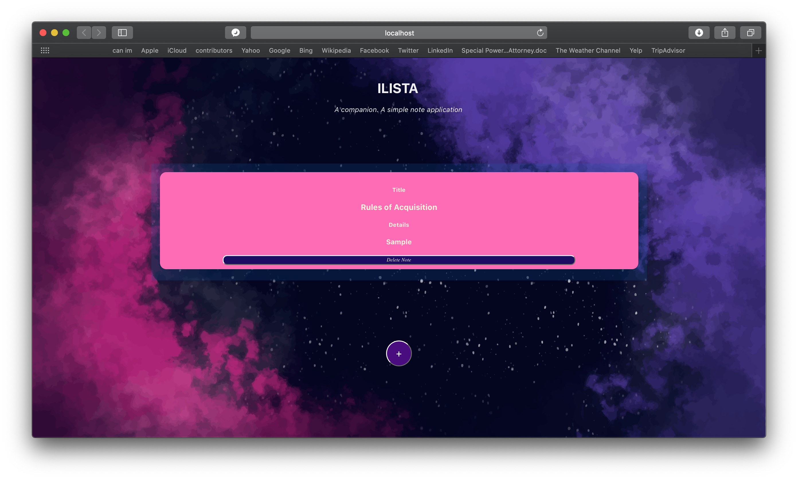
ILISTA Web application
This is how ILISTA looks in web browser

Slide 13
ILISTA RUNNING THE APPLICATION
WEB
Download the source code on open the folder via terminal/bash
Mobile
(ios)
Download source code and open folder ilsta/ilista/ios/App
Inside <directory>/ilista/ilsta run commands
$ npm install
$ npm start
Open workspace file in XCode (App.xcworkspace) and run project

Slide 14
ILISTA References
How To Build a React To-Do App with React Hooks
https://www.digitalocean.com/community/tutorials/how-to-build-a-react-to-do-app-with-react-hooks
Convert your existing react js app to android or ios app using the ionic capacitor
https://medium.com/how-to-react/convert-your-existing-react-js-app-to-android-or-ios-app-using-the-ionic-capacitor-a127deda75bd

Slide 15
ILISTA FUTure implementations
Data Persistence
Allow data to be saved in cache
Time Information
Save Time the user created the note and support reminder functionality
Mobile Hardware
Use of camera, location, mic and speaker

Slide 16
Live Long & Prosper

